Slide 1
NBA All-Star Prediction
Evelyn Ling, Ian Lin, Isaac Lei,
Kai-ying Chen, Millie You, Wharton Lin
Notes:
Ian Lin
Hi everyone, we’re presenting our final project on the topic of NBA all star prediction
our project focuses on combining player performance, media sentiment, and fan popularity to better model how All-Stars are actually selected.

Slide 2
Our Game Plan
01
02
03
04
Introduction
Datasets
Methods & Results
Conclusions
Notes:
Ian Lin
Well split into introduction, datasets, method & results, and conclusion

Slide 3
01
Introduction
Notes:
Now ill start with the introduction

Slide 4

Our Question
Which NBA players are projected to make the 2026 All-Star roster?
Notes:
our central question is Which NBA players are projected to make the 2026 All-Star roster?
More specifically, we ask whether our hybrid model that combines performance metrics with sentiment and popularity data can more reliably predict All-Star selections.

Slide 5
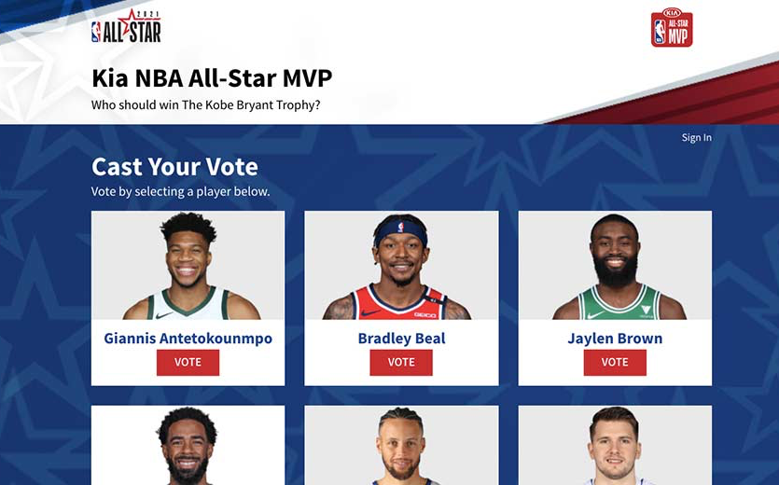
Context
All-Star selection depends on performance + popularity
  Fans (50%), Players (25%), Media (25%)
Combine traditional stats with sentiment analysis
Dataset includes:
  Player metrics: PPG, assists, rebounds, efficiency, usage rate
  Sentiment scores from ESPN & online popularity from google trend
Notes:
Moving on to context
All-Star selections aren’t based purely on performance, they’re a mix of on-court stats and public/media popularity. Fans make up half of the vote, while players and media each contribute 25%.
cuz, we wanted to combine traditional basketball statistics with sentiment analysis from online discussions. Our dataset includes standard player metrics like points, assists, rebounds, and efficiency, but we also pull sentiment scores from google trend and espn. To allow us quantify both performance and popularity at the same time.

Slide 6
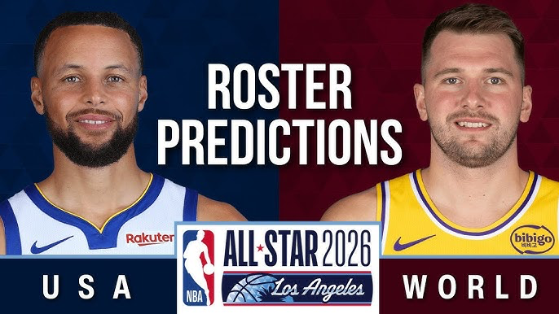
Project Motivation
Stakeholders: NBA media teams, front offices, fantasy/betting platforms (PrizePicks, DraftKings)
Benefits:
  Early All-Star forecasts backed by data, not polls
  Analytics-driven narratives for media
  Marketability insights for teams
  More accurate projection tools for fantasy & betting platforms
Notes:
Our project matters to several stakeholders including but not limited to NBA media teams, front offices, and betting platforms like PrizePicks.
our model could help generate early-season All-Star predictions based on real data instead of relying on polls.
It also provides a way to measure player reputation and marketability.
and can become a tool for more accurate projections and storylines.

Slide 7
02
Datasets
Notes:
And i'll pass it down to kai ying

Slide 8

Overview
Season-long performance stats (official NBA box score data)
Media sentiment scores (scraped ESPN news articles)
Popularity time-series (Google Trends interest over time)
Notes:
We have two models which we will later expand on, and for our first model, we used season stats, for our second model, we used popularity time series from google trends and media sentiment scores we scraped from espn articles. “For our dataset, we started with three core components.
First, we gathered full-season NBA performance statistics directly from official box score data.
Second, we added Google Trends time-series to capture how player popularity changes throughout the season.
Lastly, we included media sentiment scores by scraping ESPN articles that mention each player.
These three sources together give us performance, popularity, and media perception.”

Slide 9
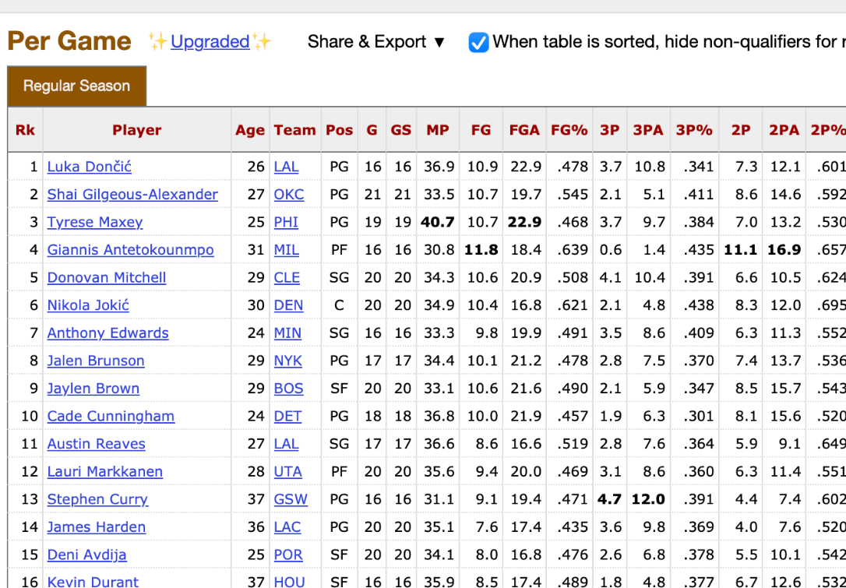
Dataset 1: Season Performance Data
Source: Scraped from Basketball-Reference (19–20, 20–21, 22–23, 23–24 seasons)
Structure: One row per team stint (traded players appear multiple times)
Columns: demographics + statistics (points, rebounds, assists, etc.)
Cleaning:
  Removed duplicate entries
  Kept the latest team stint for each player
Notes:
“Our performance dataset comes from Basketball-Reference, covering four recent NBA seasons.
Each row represents one team stint, which means players who were traded mid-season show up for each team they played for.
The dataset includes demographics along with full stat lines like points, rebounds, assists, and so on.
We cleaned the data by removing duplicates and keeping the most recent team stint to avoid double-counting.”

Slide 10
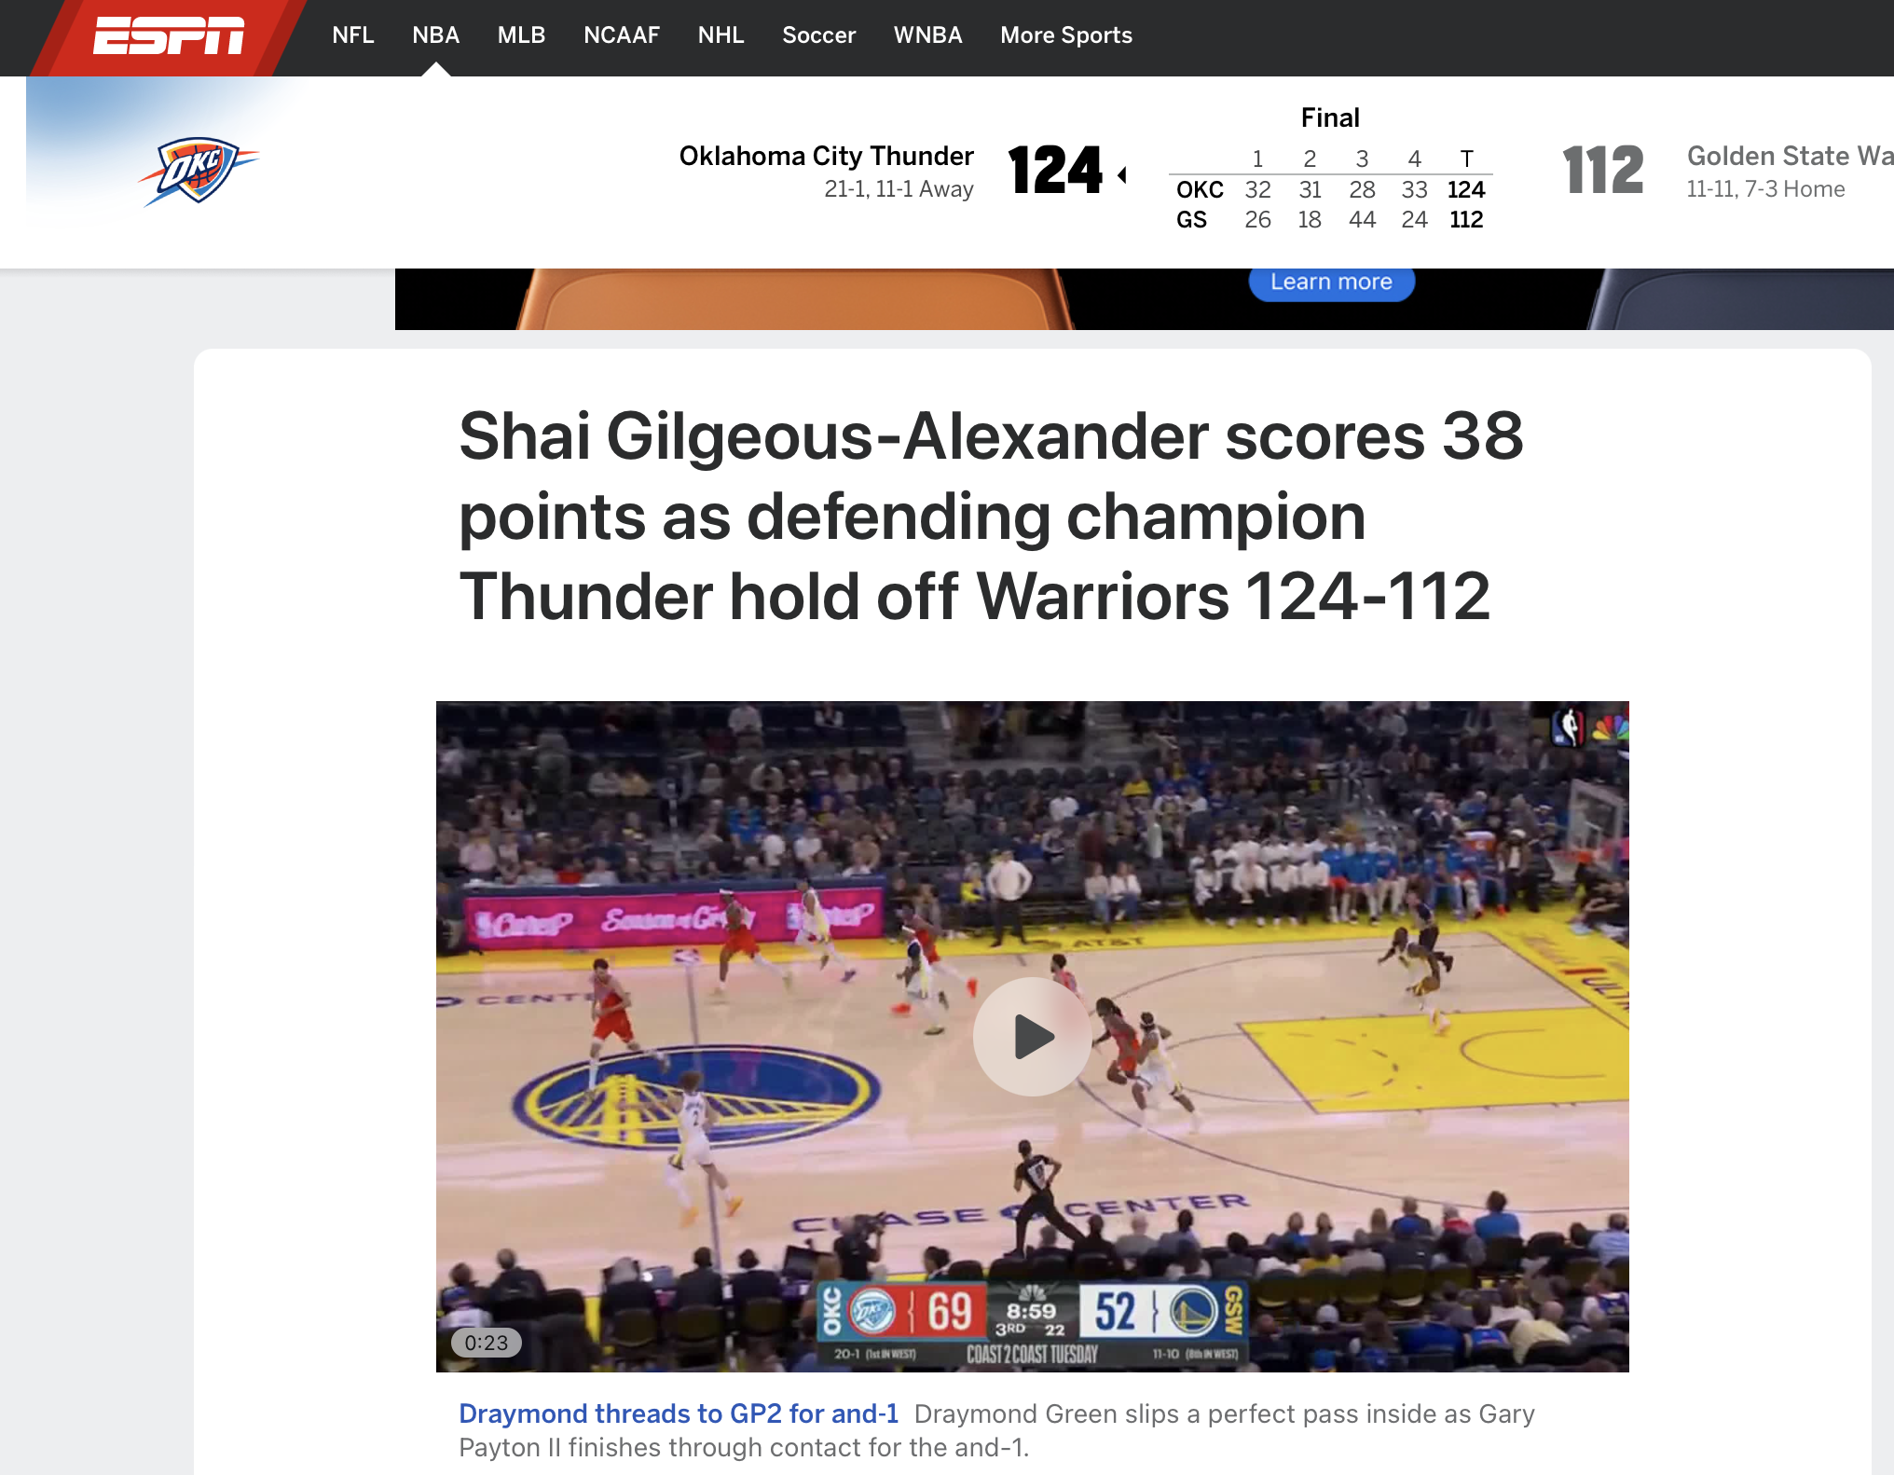
Dataset 2: Media Sentiment
Scraped ESPN news articles
Source: Google Custom Search API (espn.com/nba)
Structure: One row per headline per player per season
Raw Values:
  ESPN article titles, Snippet text, Article count per player (totalResults), Google metadata (title, link, snippet)
Cleaning:
  Removed invalid/missing headlines, Deduplicated repeated titles, Extracted article dates using regex, Standardized player names, Dropped rows without valid text for sentiment analysis
Notes:
“The detailed version of our media sentiment dataset includes all headline-level information from the API: titles, snippets, metadata, and even the total count of ESPN articles mentioning each player.
Cleaning was a major step. We removed invalid or missing headlines, deduplicated identical titles returned by the API, and used regex to reliably pull out article dates.
We also standardized player names across seasons and removed any rows where we didn’t have enough text to run sentiment processing.
This gave us a clean, structured dataset for sentiment scoring.

Slide 11
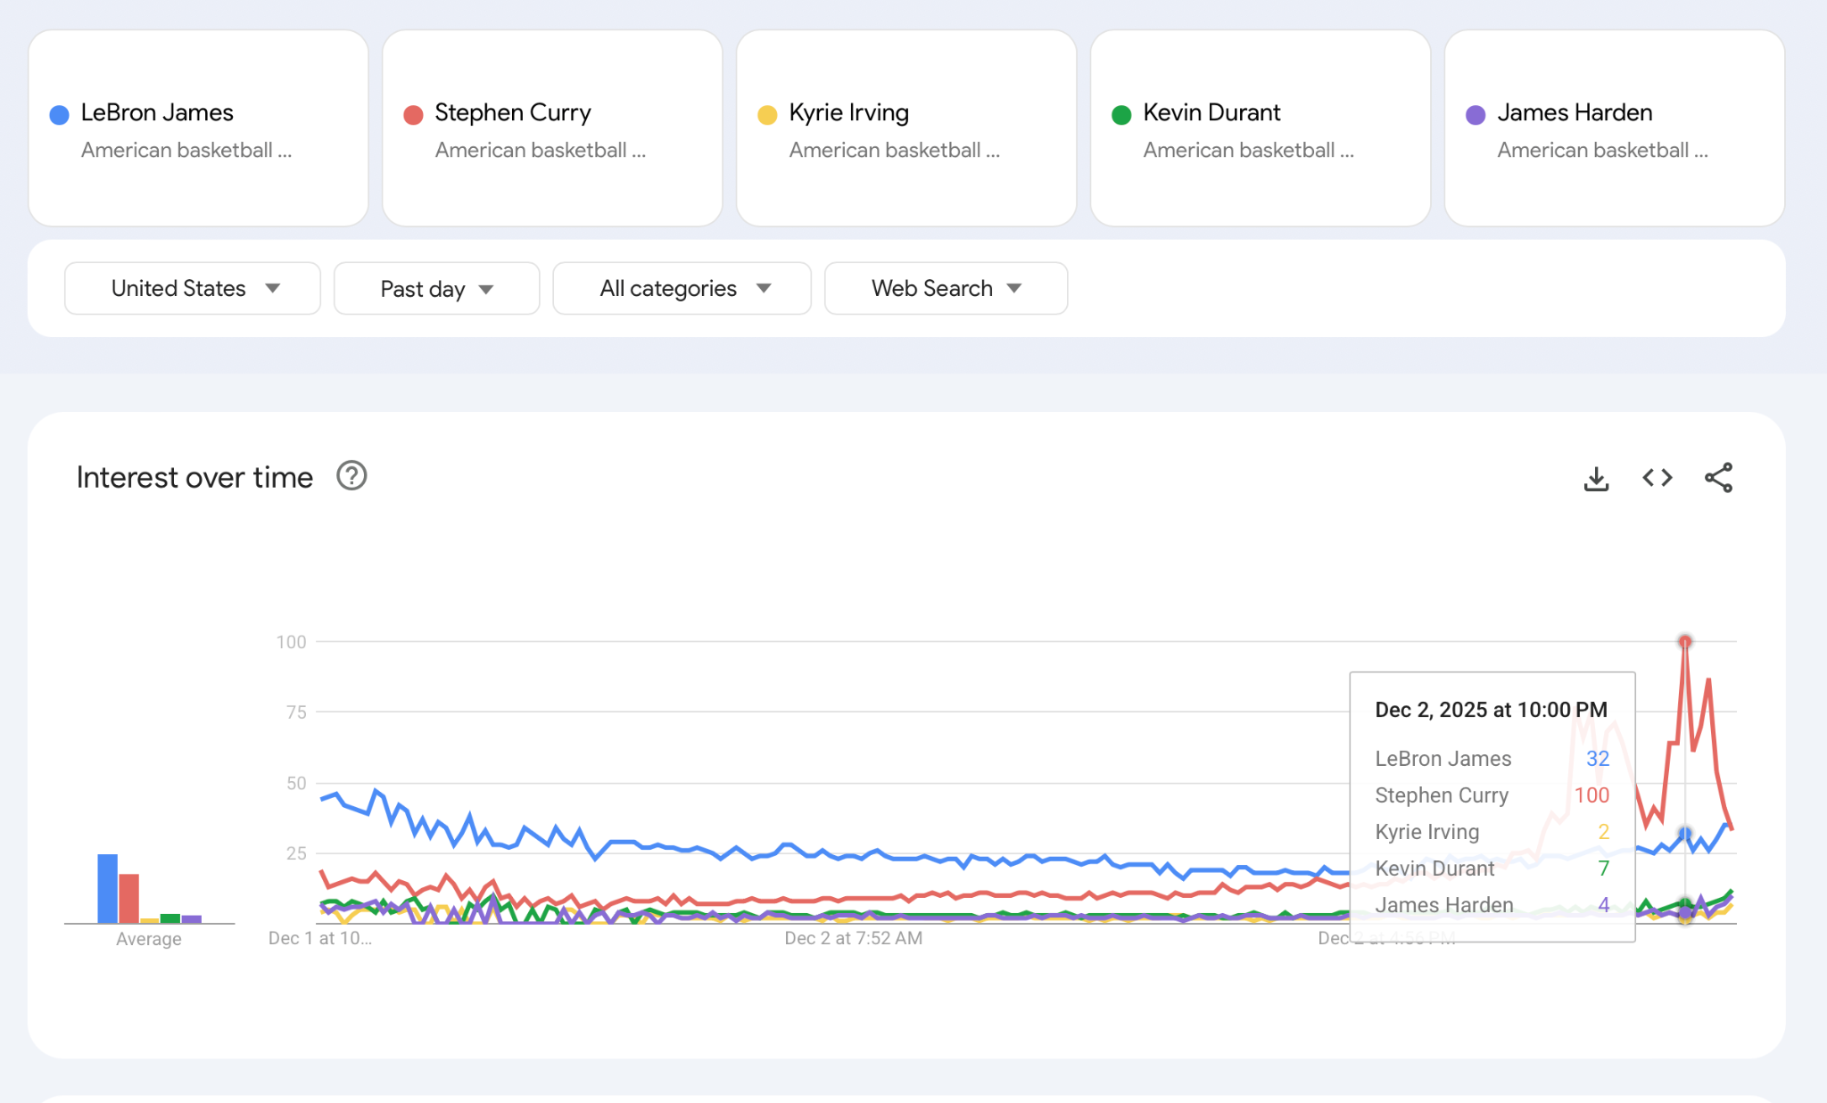
Dataset 3: Online Popularity (Google Trend)
Source: Google Trends
Structure: One row per day, one column per player
  Timeframe: start of season ~ final voting date
Raw Values:
  0-100 value based on a relative popularity of a search term, scaled so the peak interest is 100.

Slide 12
03
Methods

Slide 13
Methods: A Two-Model Approach
Solution: Split into Two Models
Why Our Approach Works:
Model 1 (Performance): Objective side (Player Stats, Efficiency, Team Success).
Model 2 (Sentiment/Popularity): Subjective side (Hype, Media Narratives, Fan Attention).
Pure performance misses underrated players; popularity alone overrated.
Mirrors Voting: reflects Fan (50%), Media (25%), Player (25%) split.
Notes:
So our predictions are based on a two-model approach. Since on-court performance is a strong indicator of being chosen, we have one model that captures it. That is Model 1, our Performance Model. but We believe that traditional stats alone cannot fully capture the “popularity factor,” so we have another model, Model 2, which is our Sentiment and Popularity Model. By combining both perspectives, we aim for a more accurate prediction.
We chose this two-model approach, since we believe that a single model would be insufficient. This is because performance-only predictions tend to overlook underrated players, while popularity-only predictions often overestimate players without strong statistical support.

Slide 14
Methods
Model 1: Statistical Performance Model
Model 2: Sentiment & Popularity Model
Features: PTS, AST, REB, STL, BLK, FG%, 3P%, FT%, +/-, Win %, Usage Rate, GS, MIN
Models used: logistic regression, neural network, random forest (ensemble)
Output: performance-based All-Star probability (0–1)
Inputs:
  Media sentiment (ESPN headlines)
  Google Trends popularity
Techniques: sentiment scoring + time-series normalization
Output: popularity-driven All-Star probability (0–1)
Notes:
More specifically, our first model pulled in traditional NBA stats. Then We ran three different models, and then combined them into an ensemble.
For Our second model, We used media sentiment from ESPN headlines and Google Trends search. We processed sentiment scores and normalized the popularity trend data.
The output for both models is a continuous probability between 0 and 1 that represents how likely a player is to be an All-Star player.

Slide 15
Final Step: Final score (Weighted Ensemble)
Goal: Combine objective (Model 1: Stats) and subjective (Model 2: Hype) scores to align with the official voting structure (Fans, Media, Players).
Model Components:
Model 1: Performance-based (Ensemble of Logistic Regression, Neural Net, Random Forest).
Model 2: Sentiment & Popularity (ESPN Sentiment Analysis + Google Trend).
Weighted Ensemble Formula:
  Final Score = α * Model 1 + (1 - α) * [ β * ESPN + (1 - β) * Google Trend ]
Parameter Tuning (Grid Search):
  α: Weighting between performance (stats) vs. hype (sentiment/popularity).
  β: Relative weight between ESPN sentiment vs. Google popularity.Output: A single, continuous All-Star probability [0, 1] per player.
Notes:
"So The final step is to produce a single final Score.
We achieve this using the formula you see on the screen. The score is a composite of Model 1 and Model 2, governed by two key parameters: $\alpha$ and $\beta$.
We then use a Grid Search approach to test combinations of the parameters. The ultimate pair is the one that maximizes our combined precision and recall, giving us the optimal balance to predict the final All-Star roster.

Slide 16
Model 1 Overview
Notes:
I’ll start by introducing Model 1.

Slide 17

Goal: Predict NBA All-Star selections
Dataset: Player stats (per-game + advanced metrics)
Approach: Build 3 models → compare → ensemble
Model 1 Overview
Notes:
Our overall goal in this project was to predict NBA All-Star selections. To do this, we used a dataset containing both per-game and advanced player statistics. The idea was to build three different models, compare their performance, and then create an ensemble to get a final, more stable prediction.

Slide 18

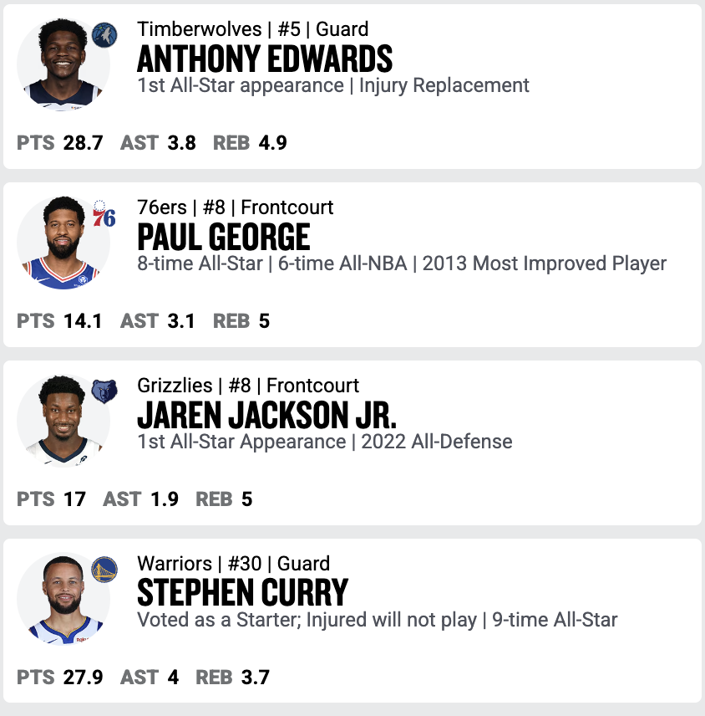
Data Preparation (Model 1)
Data Cleaning
Missing data from players
  Set to 0
Ambiguous team names (ex: 2TM)
  Remove player rows
Data Enrichment
Adding All Star boolean column (target label)
  Manually check on NBA website for all 5 years
  Ignore injury replacement players
Notes:
For data cleaning, we handled missing values by setting them to zero, since these usually represented players with limited recorded stats.
We removed players with ambiguous features.
To create the target label, we added a boolean column indicating whether a player was selected as an All-Star and manually verified All-Star selections using the NBA website across all five years.

Slide 19
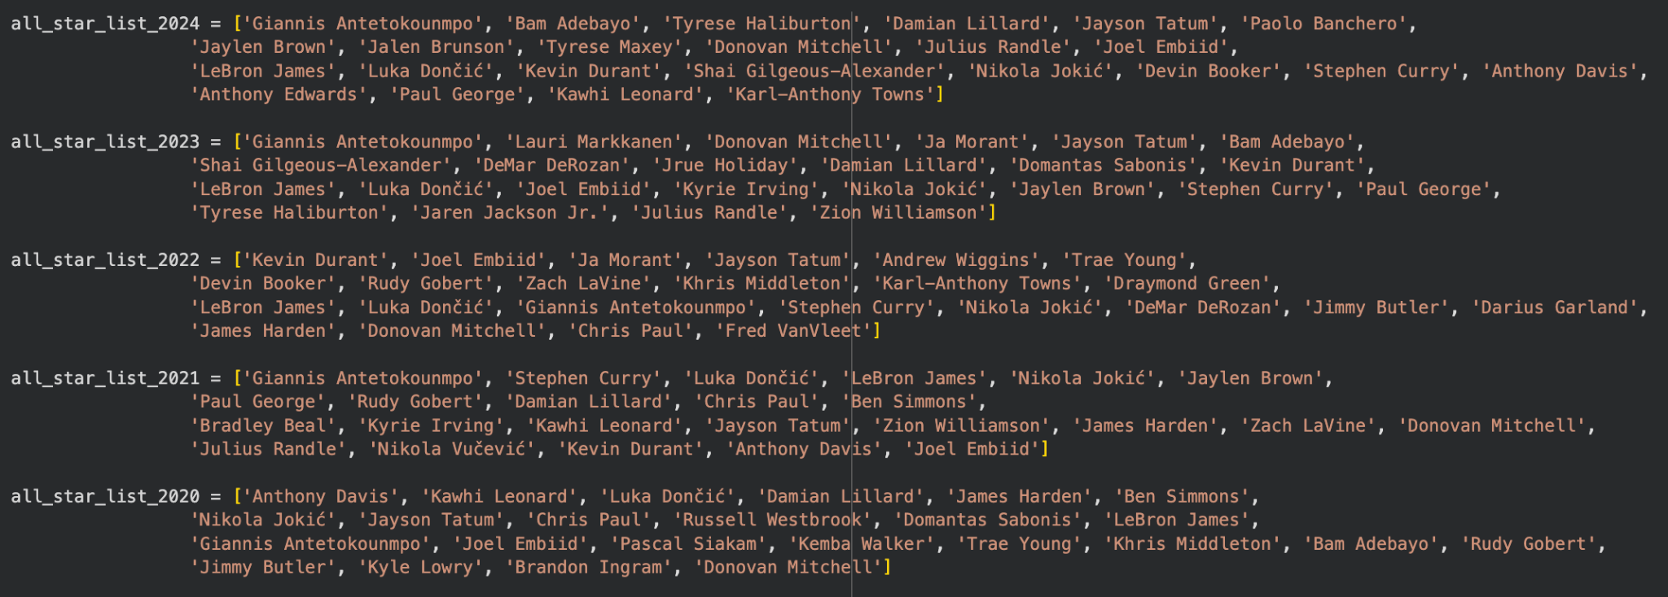
Data Preparation (Model 1)
Notes:
We created a list for every all star year and these are all the name lists

Slide 20
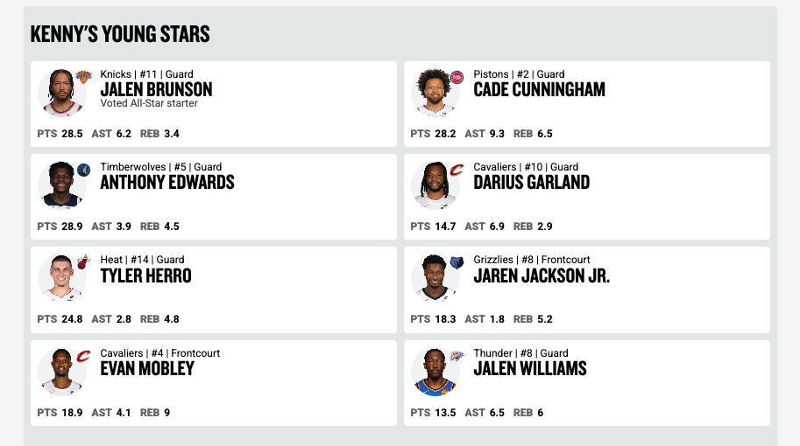
Data Preparation (Model 1)
Train and Test
Train: 2020, 2021, 2022, 2023 (concat)
Test: 2024
Predict: 2026
Skip 2025 due to different format
2024-2025 Data
Notes:
For training and testing, we combined the 2020 through 2023 seasons into our training set.
We used 2024 as the test year.
We skipped 2025 because the data format was inconsistent, and finally, the goal was to predict the 2026 season.

Slide 21
The 3 Models
1. Logistic Regression
2. Neural Network
3. Random Forest
Linear model for probability prediction
Fast, interpretable baseline
Outputs smooth probability scores
Useful for identifying impactful features
2-layer fully connected network
Learns complex nonlinear structures
Produces probability output
Ensemble method
Averages results of individual trees
Improve accuracy while controlling overfitting
Learns complex nonlinear structures
Notes:
We trained three models—Logistic Regression, a simple Neural Network, and a Random Forest.
Since each model captures different patterns, combining them gives us a more reliable overall prediction.
Logistic Regression provides a fast, interpretable baseline that highlights important features and produces smooth probability scores.
The Neural Network learns more complex nonlinear patterns that simpler models might miss.
The Random Forest combines many decision trees to capture rich nonlinear relationships while reducing overfitting and improving accuracy.

Slide 22
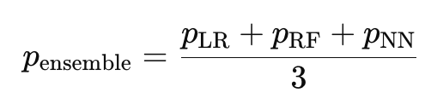
Ensembling the Outputs
Comparing Model Outputs
Ensemble Method → Final Output
Final prediction = average of three model probabilities
Formula:
Sort players by combined All-Star probability
Set top-k players to 1 for All Star Prediction
  Compare with actual label
Produced top predicted All-Stars list
More stable than any single model
Ensemble performed best overall
Each model outputs a probability:
  P_log_reg
  P_random_forest
  p_neural_net
Different models emphasize different statistics
Variation across models helps reduce bias
Notes:
Each model gives us its own probability score and highlights different statistics and patterns, so combining their outputs helps reduce bias and noise.
Our final prediction is simply the average of the three model probabilities.
We sort players by this combined probability and label the top-k players as All-Stars.
We then compare those predictions to the actual results.
Overall, the ensemble was more stable and more accurate than any individual model.

Slide 23
Challenge (Model 1)
Drastic Class Imbalance
~500 players per season
Only 24 all star players
  ~5% of the target labels are 1 (All Star); rest are 0 (Non-All star)
Accuracy is not a good error metric
Solution:
  Focus on precision, recall, f1

Slide 24
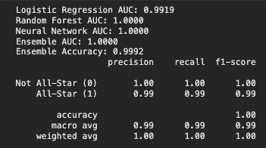
Initial Train Data Evaluation

Slide 25
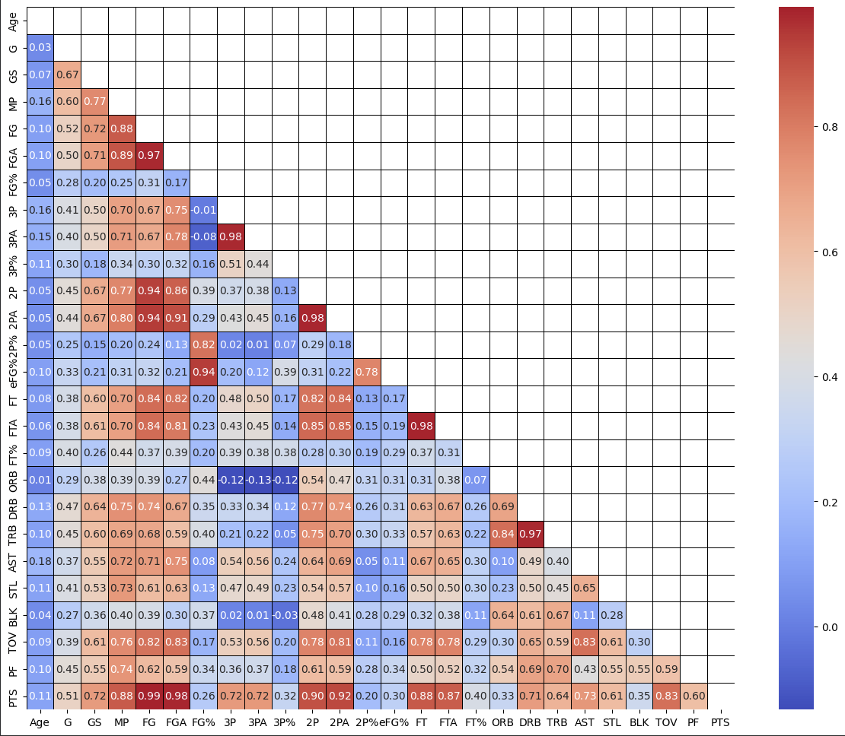
Challenge (Model 1)
Feature Correlation Matrix
Overfitting
Reason 1: Many high correlated features
  Ex:
    FG vs PTS: 0.99
    FGA vs PTS: 0.98
    TRB vs DRB: 0.97
These stats capture similar information so the model double counts these features
Solutions
  Drop redundant features
  Removed features: 'MP', 'FG', 'FGA', 'FG%', '3PA', '2P', '2PA', 'FT', 'FTA', 'TRB', ‘TOV'
26 numerical features in raw data

Slide 26
Challenge (Model 1)
Overfitting
Reason 2: Models failed to generalize
  Random Forest & Neural Network
Solutions:
  Random Forest
    Max_depth = None -> 5
    Min_samples_split = 2 -> 5
  Neural Network
    Add alpha = 0.01
    hidden_layer_sizes=(64, 32) -> (32, 16)

Slide 27
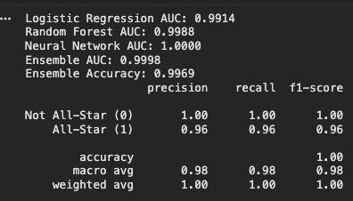
Train Data Evaluation
Before model + feature adjustments
After model + feature adjustments

Slide 28
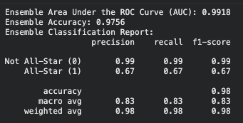
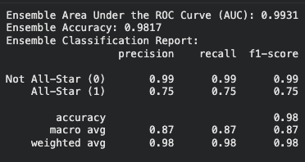
Test Data Evaluation (2024 All Star)
Before model + feature adjustments
After model + feature adjustments

Slide 29
Model 2 Overview

Slide 30
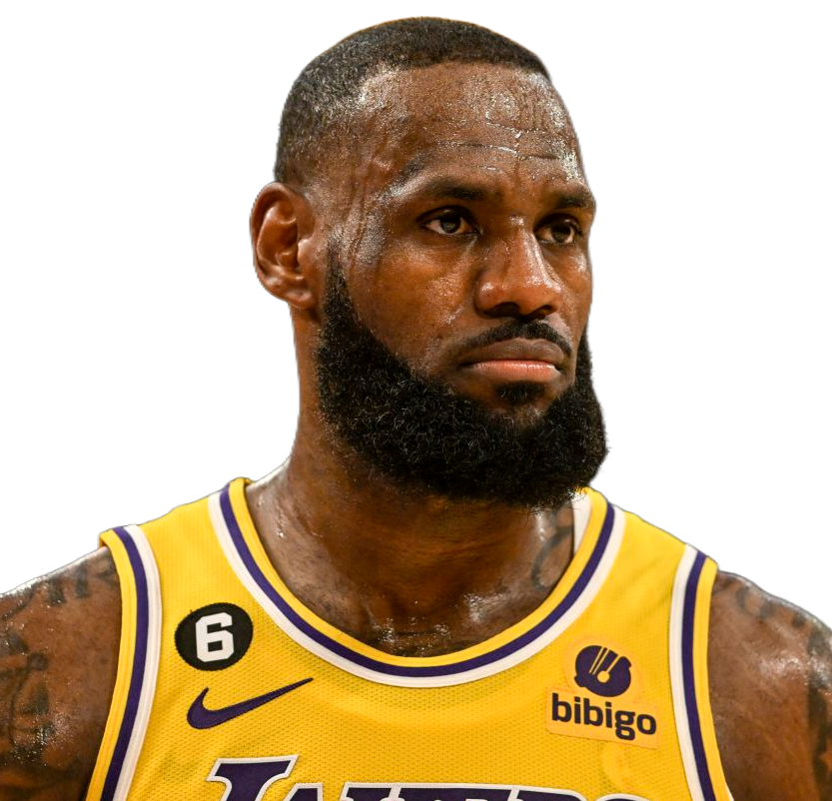

Model 2 Overview
Focuses on Sentiment / Popularity
  Do people like the player?
  Is the player famous?
👑
😡

Slide 31
Sentiment Analysis
ESPN Sentiment Analysis
Media accounts for 25% of the total vote
Scrape ESPN Articles through Google Search Custom API
Scrape 10 articles per player / per season
  Efficient query -> (takeaways OR analysis OR grades OR breakdown)
  Calculate Avg Sentiment Score of 10 articles -> [0, 1] using ntlk
  Popularity Component (# total num of ESPN articles returned)
  Sentiment Component (Avg Sentiment Score of 10 articles)
final_sentiment_score = ALPHA * popularity_component + (1 - ALPHA) * sentiment_component
Notes:
"Model 2 is our way of capturing the subjective side of the All-Star vote, and we begin by addressing the media's 25% share. We hypothesize that the media's vote is primarily driven by the player narratives and the sheer volume of coverage they generate.
To quantify this, we used the Google Search Custom API to specifically target and scrape analytical articles from ESPN, a key voice in the NBA landscape.
Crucially, we didn't just scrape every mention. We implemented an efficient query filter using keywords like 'analysis,' 'breakdown,' or 'takeaways'. This ensures we are collecting articles that offer substantive journalistic assessment, rather than just simple game recaps. We capped this collection at 10 articles per player per season.
We then broke this down into two distinct components:
The Sentiment Component uses the NLTK library to calculate an average sentiment score. This measures the tone of the media narrative—how positive or negative the coverage is.
The Popularity Component is a measure of sheer volume. This is simply the total number of ESPN articles returned for the player query, serving as a proxy for the overall media attention or 'hype.'
Finally, we combine these two factors into a Final Sentiment Score using the ALPHA parameter. This $\alpha$ allows us to tune how much weight we place on a player's narrative depth (the quality of the sentiment) versus their media footprint (the volume of popularity). This resulting score is the first half of our Model 2, which we then combine with the Google Trend analysis."

Slide 32
Popularity Analysis
Google Trends
Processing:
  Players are processed in batches of 4 + LeBron James
  Each batch is scaled relative to LeBron’s maximum in the first batch
  All data are normalized by the peak to a 0-100 scale.
Data Extraction:
  trends_mean= average search interest over time
  trends_last30 = average search interest in last 30 days before selection
  trends_max = highest value (peak) for a player
  trends_slope = Slope of linear regression line, which indicates a player's trend direction and strength.
Normalize and score: Each player's features are normalized, weights are defined, and combined to calculate a final score.
Notes:
"While the ESPN Sentiment Analysis captured the media's influence, the largest share of the vote, which is 50 percent, comes from the fans. We model this fan interest using Google Trends Analysis.
However, Google Trends data is relative and we are only able to extract by batches of 5 search terms, so we needed a normalization strategy.
We processed the data in batches, using LeBron James as an anchor in each one. Then all players’ values were normalized to ensure consistent comparisons.
Then we extracted four features from this dataset:
The Mean Interest of each player.
The Last 30-Day Interest of each player
the highest single moment of hype of each player.
And the Trend Slope, which indicates each player's trend direction and strength
Then we normalized these features, defined weights, and combined them to calculate the player's final Popularity Score. This score, alongside our ESPN Sentiment Score, completes our Model 2."

Slide 33
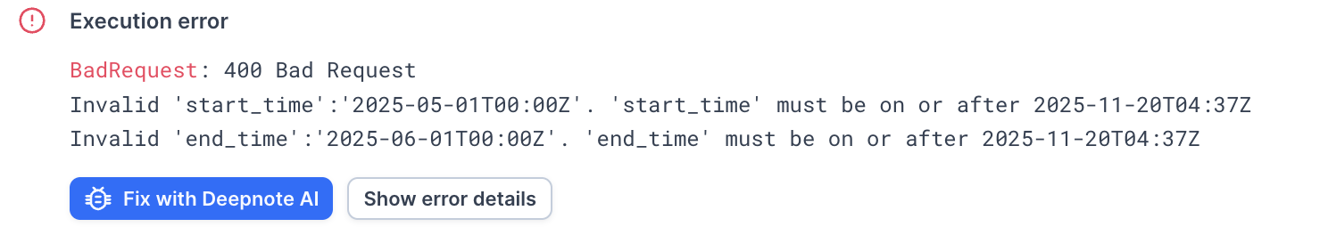
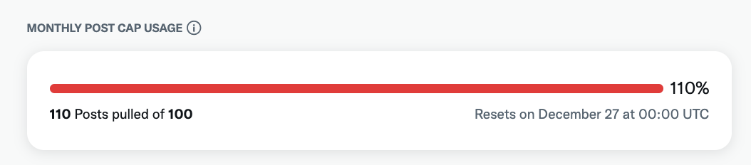
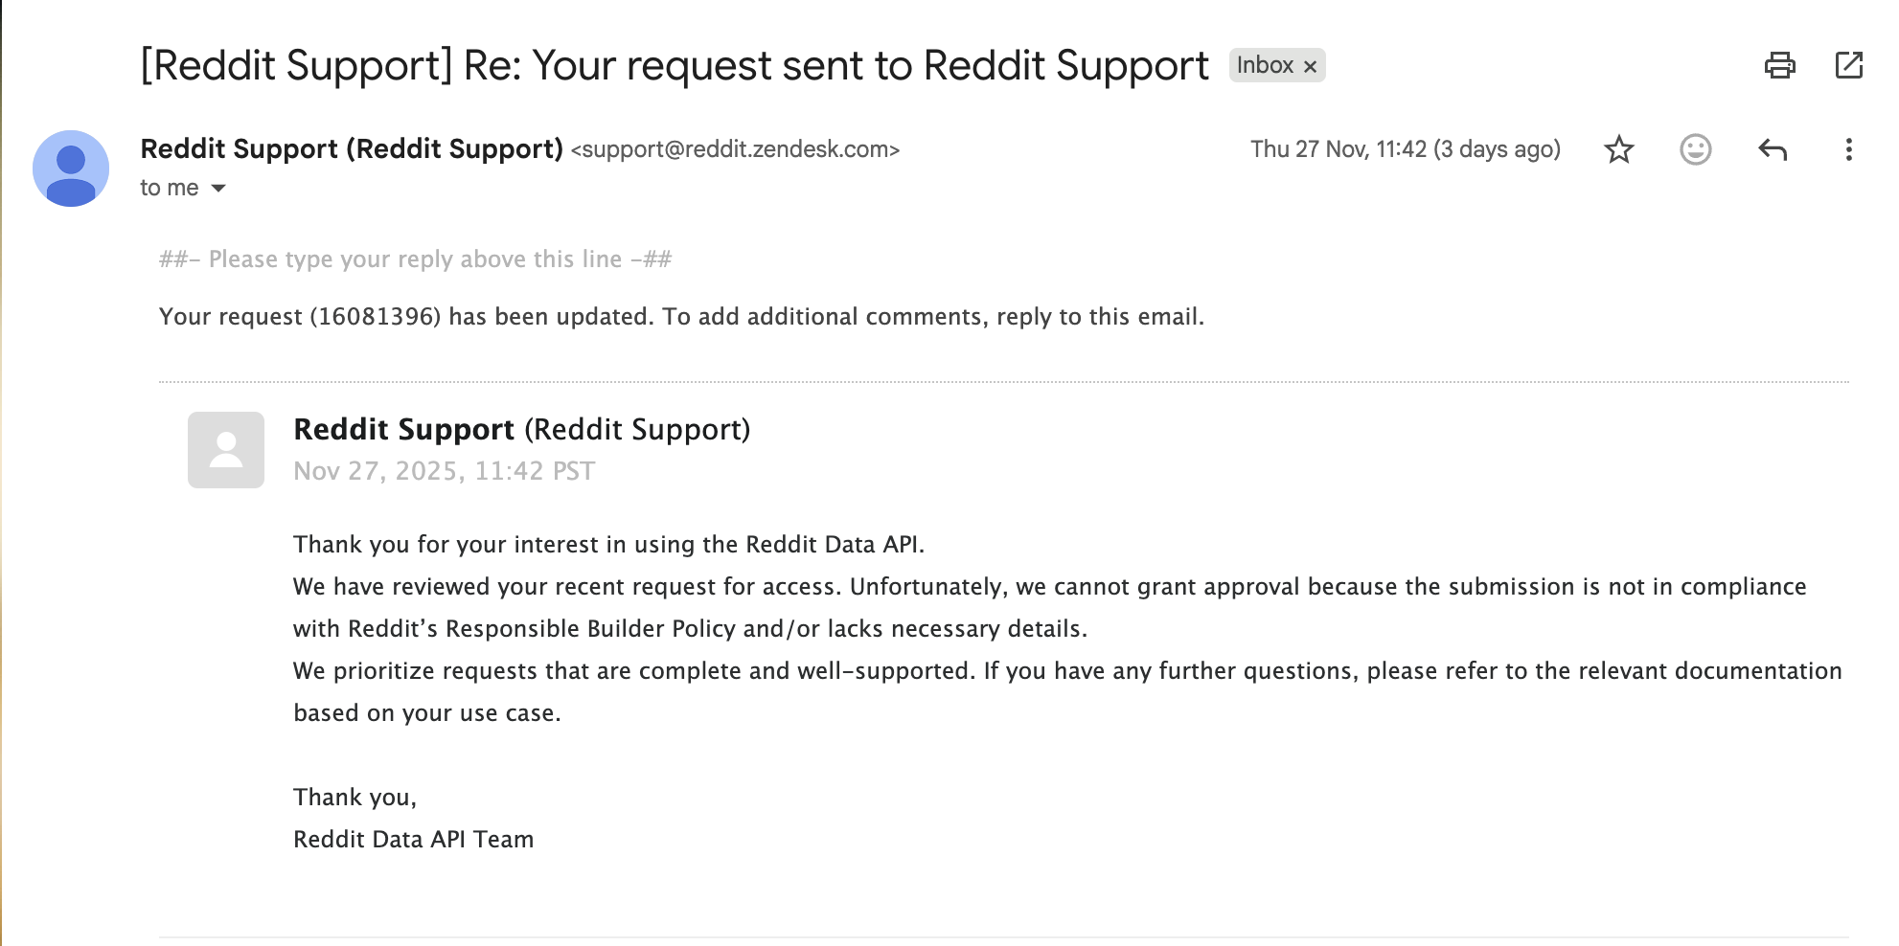
Challenges:
Insufficient Information:
Reddit developer account rejected
X (Twitter)
  Unable scrape twitter post before 11/20, 2025
Pytrends: Can only scrape 5 player’s popularity each time
Notes:
We faced a few challenges when developing Model 2. Initially, we wanted to scrape Reddit and X for sentiment analysis. However, our reddit developer account got rejected. And for X, we found that we were not able to scrape posts before 11/20/2025. Another challenge was pytrends, which we used to extract the data from Google trends. It can only extract 5 player’s trends each time, but we were able to overcome this by normalizing based on an anchor.

Slide 34
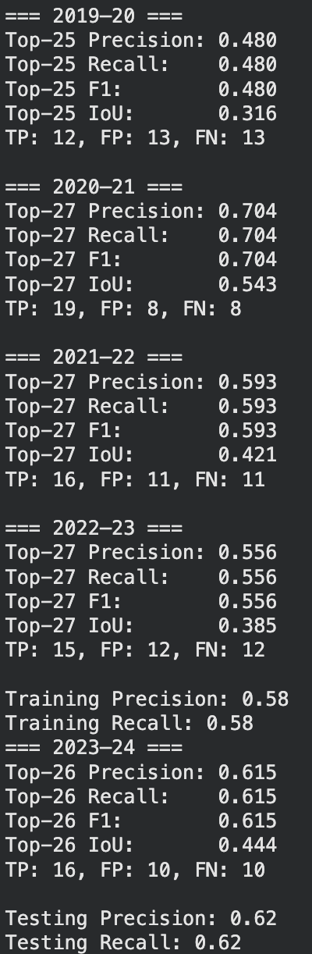
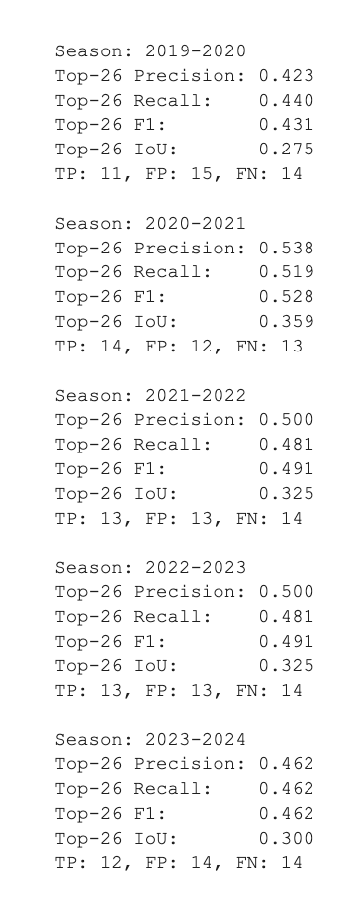
Results (Model 2)
Model 2: Sentiment Analysis
Model 2: Popularity Analysis

Slide 35
04
Results & Conclusions

Slide 36

Base Model (Naive Model)
Imbalance data (Each Season: 550+ players / 24 all star)
Naive Model (Predict 24 players randomly)
  Accuracy = 0.955
  Precision = 0.045
  Recall = 0.045
Precision / Recall > Accuracy

Slide 37

Results (Combination of All Models)
Train
Test
Best alpha: 0.78
Best beta: 0.000
Precision: 0.979
Recall: 0.979
Precision: 0.73
Recall: 0.79
Alpha and Beta were determined through grid search
Model 1 dominates (alpha = 0.78), google trend more useful than ESPN sentiment
Hybrid score = 78% * model 1 + 22%[0% *ESPN + 100% *google trend]

Slide 38
Conclusion
Hybrid score = 78% * model 1 + 22%[0% *ESPN + 100% *google trend]
Key findings
Model 1 were the most predictive of all star selection
  Alpha = 0.78, giving heavy weight to on-court production
Online Popularity contributed meaningful, outperforming media sentiment
  Beta = 0 shows online popularity > ESPN sentiment
Hybrid model achieves strong real world alignment
  Precision 0.73, recall 0.79 on unseen test data
Model interpretation
Driven primarily by performance with popularity providing the second strongest signal
Sentiment (ESPN) had limited predictive power relative to other two
The ensemble captures multiple dimensions of all stat voint : performance, media, and fan interest

Slide 39
Conclusion
Overall takeaway
A hybrid model combining stat+popularity+sentiment provides a more complete and fair prediction than any individual model
The method is flexible and can generalize to future seasons with updated data

Slide 40
Readiness for Use in Real-World
Model Prediction & Reliability
Voting Aligned Prediction Capability
Hybrid model achieves strong performance:
Precision = 0.73, Recall = 0.79 on the test set
Indicates the model captures real All-Star selection dynamics
Weighted ensemble reflects the real All-Star voting structure
Stats (Model 1) → mirrors media/player evaluation
Popularity (Model 2) → mirrors fan voting Sentiment (Model 2) → complements narrative effect
Notes:
Ian lin
More importantly, our predictions aligned with the actual voting composition. The weighted ensemble reflects the real All-Star voting structure:
performance-based stats mirror how players and media evaluate talent, while popularity captures fan voting influence, and sentiment adds narrative context.
Together, this makes our predictions structurally aligned with how All-Stars are actually chosen.

Slide 41
Readiness for Use in Real-World
Practical Readiness
Real-World Impact
Produces a single Hybrid All-Star Score per player
Can generate real-world projections by ranking players across conferences & positions
Easily extendable to live NBA data (updated box scores, trending metrics)
Useful for analysts, fantasy players, and sports journalists
Provides transparent, data-supported All-Star forecasts
Reveals underlying selection biases (performance vs hype)
Notes:
Ian lin
From a practical perspective, our model produces a single Hybrid All-Star Score that allows easy player ranking across conferences and positions.
The pipeline can incorporate live box score data and popularity trends to update predictions during the season.
Overall, the model provides transparent, data-driven All-Star forecasts and helps identify selection biases where popularity may outweigh performance.

Slide 42
Potential Next Steps
Improve Model Architecture
Expand Data Resources
Explore
  Gradient-boosted ensembles (XGBoost, LightGBM)
  transformer-based text models
Add calibration to ensure predicted probabilities match real voting likelihood
Social media engagement metrics (Twitter/X, Reddit, TikTok)
Add more nuanced sentiment signals (player mentions, tone shifts)

Slide 43
Potential Next Steps
Interpretation & Bias Analysis
Analyze mismatches between performance and fan popularity
Identify underrated or overhyped players
Study whether the model exposes systemic biases (market size, media coverage)

Slide 44
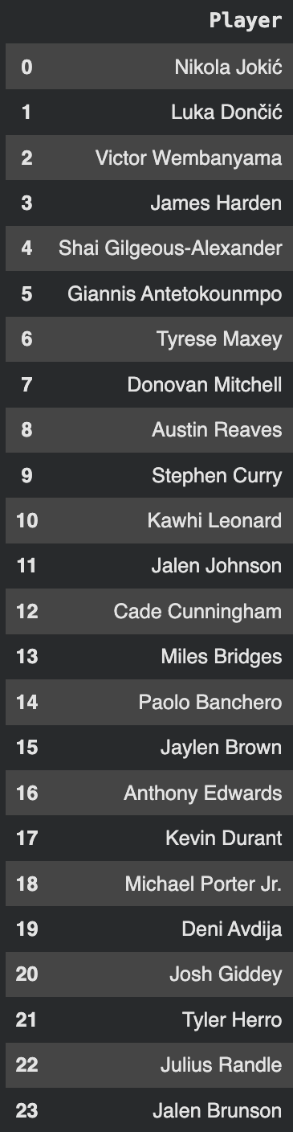
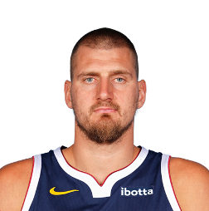

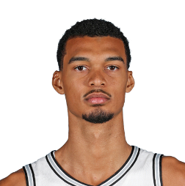

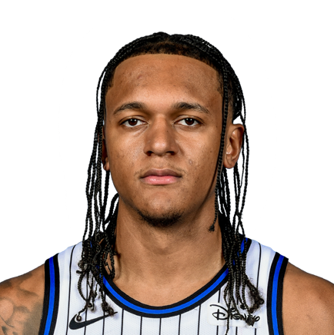
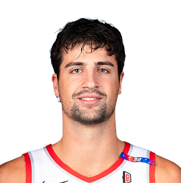
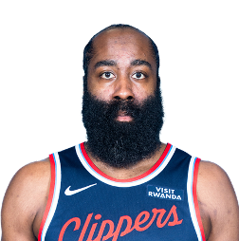

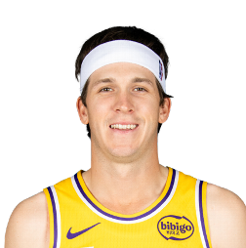

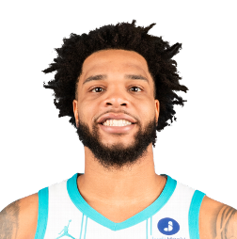

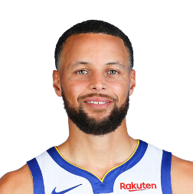

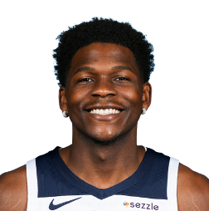


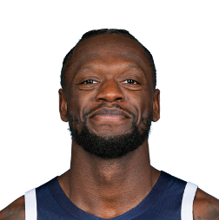
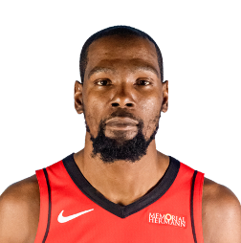
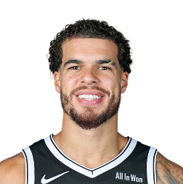
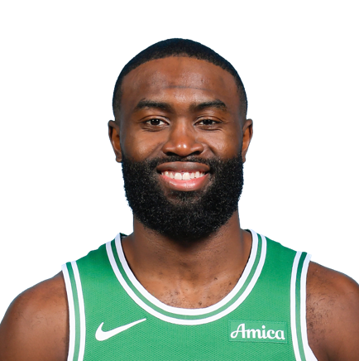


Results
West
East

Slide 45


